Slide 1
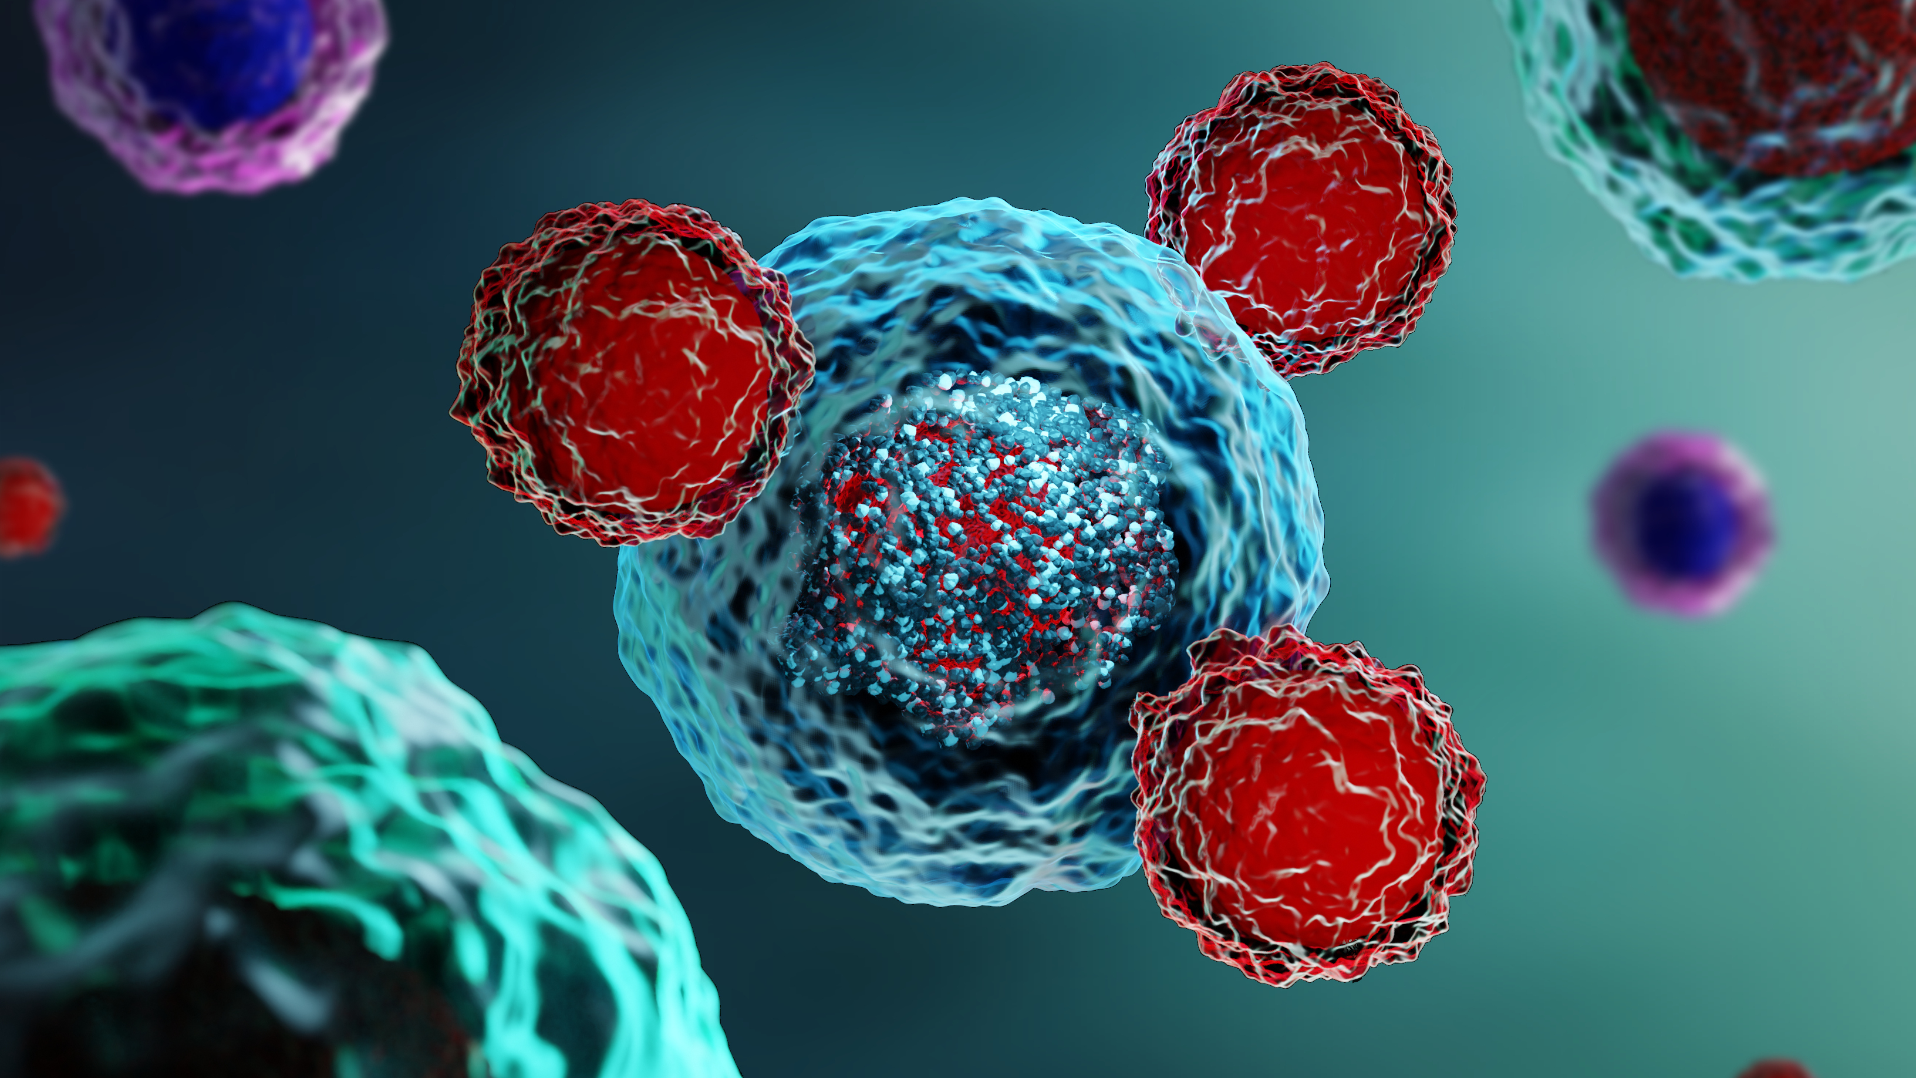
Introduction to Chimeric Antigen Receptor (CAR) T-cell Therapy
Peter Riedell, MD
University of Chicago Medicine Comprehensive Cancer Center

Slide 2
Learning Objectives
Introduction to CAR T-cell Therapy
Describe the mechanism of action of CAR T-cell therapy
1
Elaborate on the current FDA approved indications for CAR T-cell therapy
2
Outline considerations for CAR T-cell candidacy
3
Discuss the potential side effects and toxicities of CAR T-cell therapy
4
Understand the CAR T-cell treatment journey
5
Identify ways treatment centers and referring providers can collaborate to facilitate CAR T-cell therapy
6

Slide 3
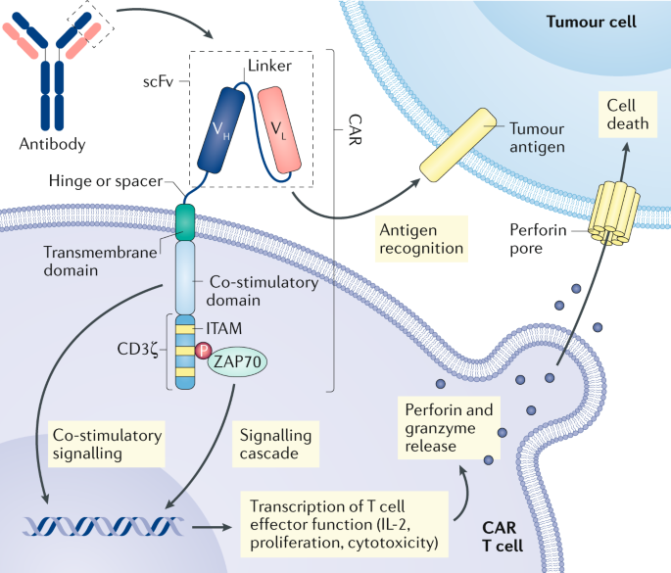
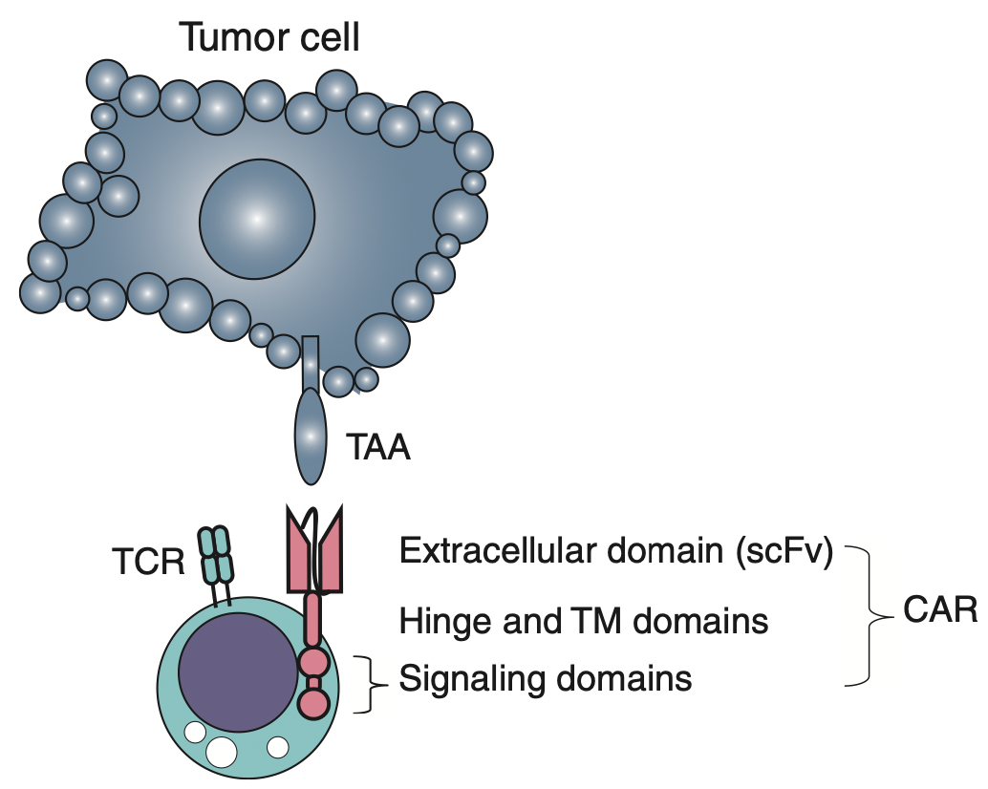
Chimeric Antigen Receptor (CAR) T-cell Therapy
Introduction to CAR T-cell Therapy
Chimera: part antibody molecule, part T-cell–activating molecule
CAR T-cell
Larson RC, et al. Nat Rev Cancer. 2021;21:145-161

Slide 4
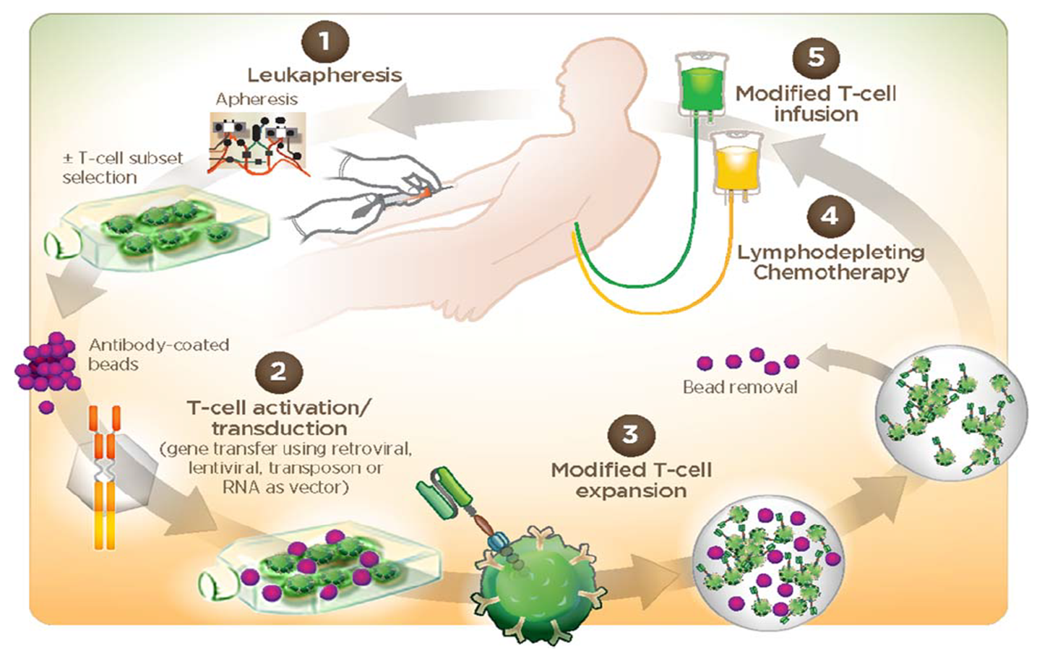
CAR T-cell Clinical Process
Introduction to CAR T-cell Therapy
Frey N, et al. Am J Hematol. 2016;91:146-150

Slide 5
2024 Snapshot of CAR T-cell Therapy Regulatory Approval in Leukemia, Lymphoma, and Myeloma
Introduction to CAR T-cell Therapy
CD19-Targeting Therapies | Indications
Axicabtagene ciloleucel | Adults with large B-cell lymphoma refractory to 1L chemoimmunotherapy (CIT) or that relapses ≤ 12 months of 1L CIT Adults with R/R large B-cell lymphoma after ≥2 lines of systemic therapy Adults with R/R follicular lymphoma after ≥2 lines of systemic therapy
Brexucabtagene autoleucel | Adults with R/R B-cell acute lymphoblastic leukemia Adults with R/R mantle cell lymphoma
Lisocabtagene maraleucel | Adults with large B-cell lymphoma refractory to 1L CIT or that relapses ≤ 12 months of 1L CIT. Adults with large B-cell lymphoma with refractory disease to first-line CIT or relapsing after first-line CIT who are not eligible for autoSCT due to comorbidities or age Adults with R/R large B-cell lymphoma after ≥2 lines of systemic therapy Adults with R/R CLL/SLL after ≥2 lines of therapy including a BTK inhibitor and BCL-2 inhibitor
Tisagenlecleucel | Patients aged up to 25 y with B-cell acute lymphoblastic leukemia that is refractory or in second or later relapse Adults with R/R large B-cell lymphoma after ≥2 lines of systemic therapy Adults with R/R follicular lymphoma after ≥2 lines of systemic therapy
BCMA-Targeting Therapies | Indications
Ciltacabtagene autoleucel | Adults with R/R multiple myeloma after 1 or more prior lines of therapy, including a proteasome inhibitor, and an immunomodulatory agent, and are refractory to lenalidomide
Idecabtagene vicleucel | Adults with R/R multiple myeloma after 2 or more prior lines of therapy, including a proteasome inhibitor, an immunomodulatory agent, and an anti-CD38 monoclonal antibody
1L: first-line; CIT: chemoimmunotherapy; R/R: relapsed or refractory; autoSCT: autologous stem cell transplantation

Slide 6
Identifying Appropriate Candidates for CAR T-cell Therapy
Introduction to CAR T-cell Therapy
Patient Considerations
Age is NOT a barrier
Fitness/functional status
Assess relevant comorbidities
Potentially mitigate with close monitoring and specialty consultation
Disease burden and characteristics
Prior treatment response
Further considerations
24/7 caregiver support
Reside in proximity of treating center for 30 days following infusion
No driving for 8 weeks following infusion
Financial toxicity
Logistics
Measurable Disease
NOTE: Transplant ineligible ≠ CAR T ineligible
Shadman M, et al. Blood. 2022;139(9):1330-1339
Frontzek F, et al. Ther Adv Hematol. 2022;13:20406207221103321
González Barca E. Front. Immunol. 2022;13:909008.

Slide 7
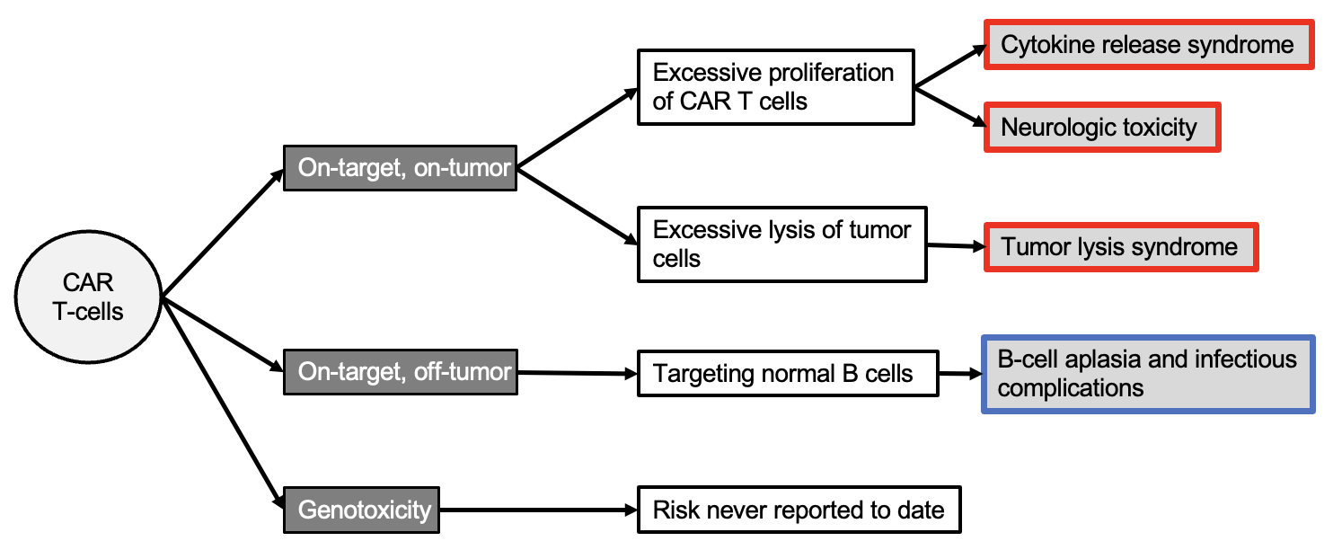
CAR T-cell Therapy Toxicity
Introduction to CAR T-cell Therapy
Within first 30 days
Unclear risk to date
Beyond first 30 days
Adapted from Kalaitsidou et al. Immunotherapy, 2015

Slide 8
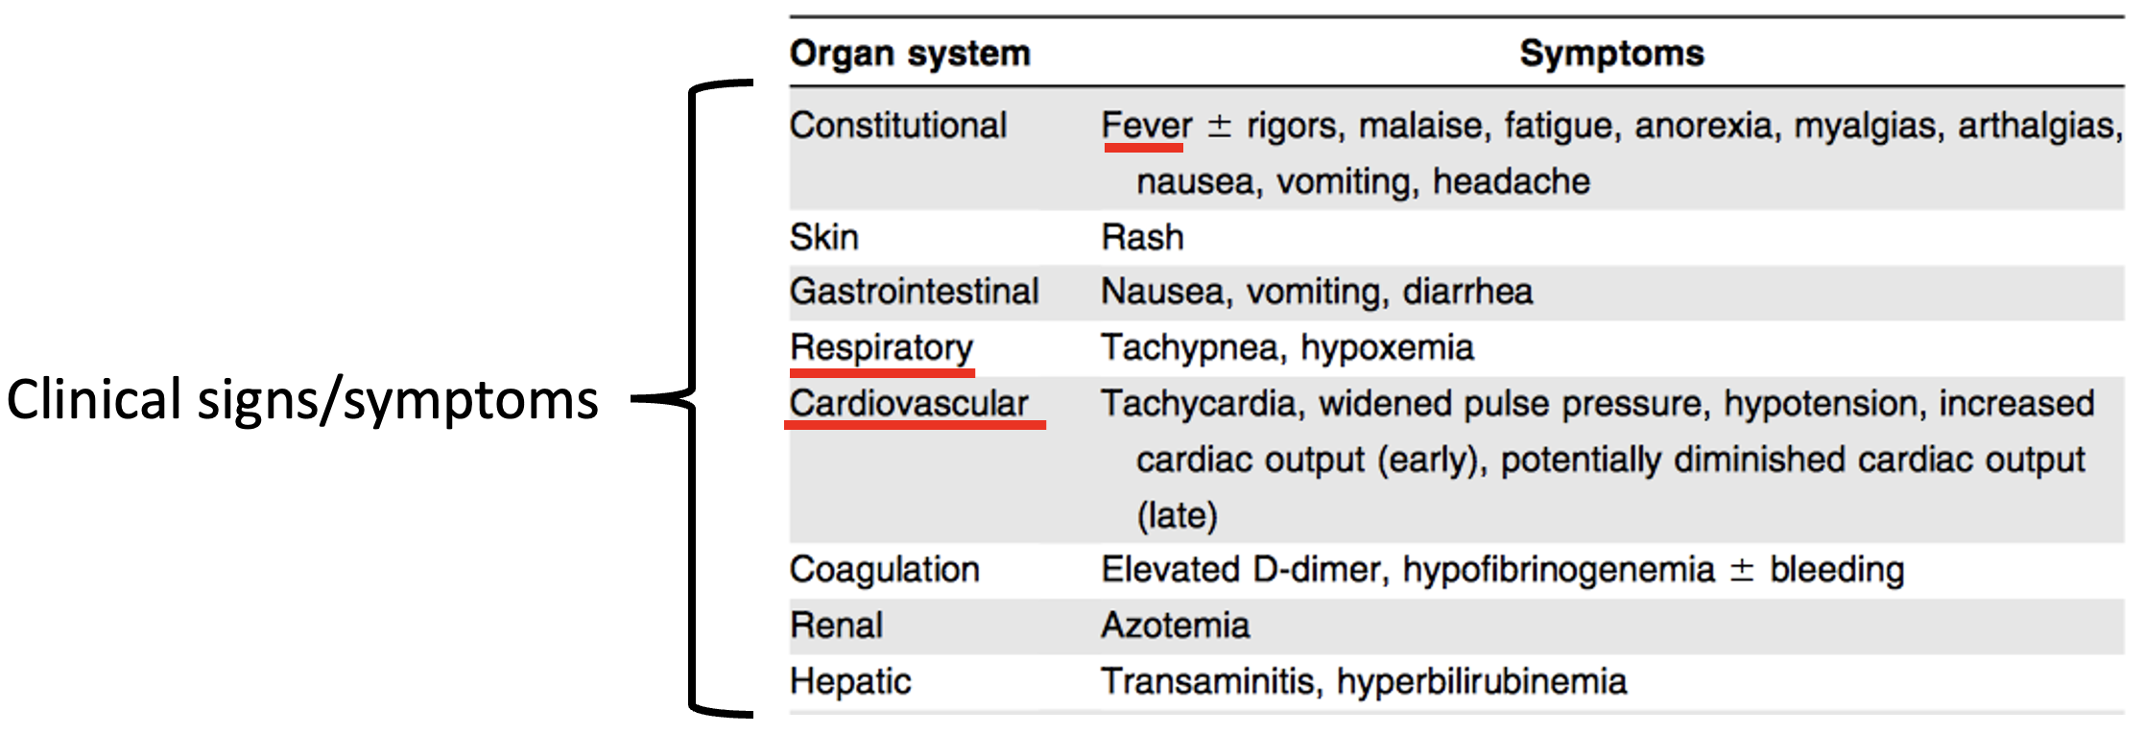
Cytokine Release Syndrome (CRS)
Introduction to CAR T-cell Therapy
CRS results from high-level immune activation
Massive release of cytokines/chemokines from CAR T cells, dendritic cells, monocytes/macrophages, etc.
Lee DW et al. Blood. 2014;124(2):188-195.

Slide 9
CAR T-cell Neurologic Toxicity
Introduction to CAR T-cell Therapy
Immune Effector Cell-Associated Neurotoxicity Syndrome (ICANS)
Can present with:
Impairment of cognitive skills
Altered level of consciousness
Aphasia
Motor weakness
Seizures
Cerebral edema
Lee DW et al. Biol Blood Marrow Transplant. 2019;25:625-638.
Neelapu SS et al. Nat Rev Clin Oncol. 2018;15:47-62.

Slide 10
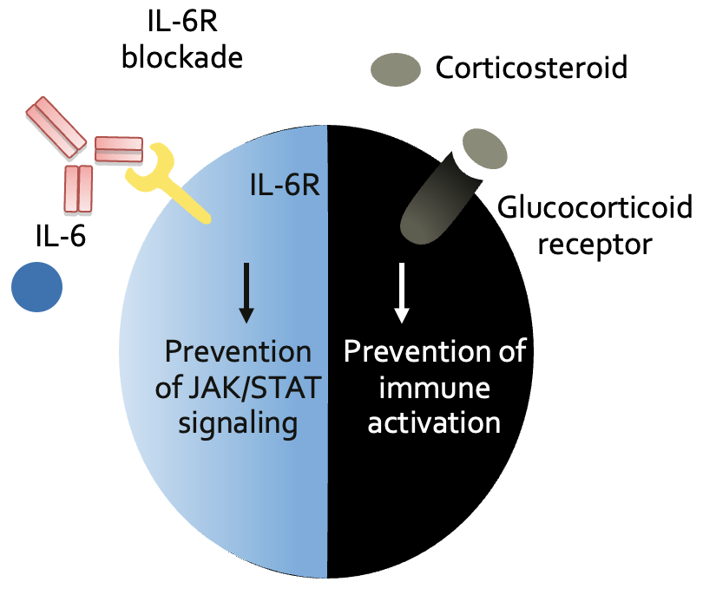
Toxicity Management: Anti–IL-6 and Corticosteroids
Introduction to CAR T-cell Therapy
Immune Effector Cell
Tocilizumab
Bonifant CL, et al. Oncolytics. 2016;3:16011
Lee DW, et al. Blood. 2014;124:188-195.

Slide 11
CAR T-cell Therapy Workflow
Introduction to CAR T-cell Therapy
Initial Consult Visit
Meet clinic team, review CAR T-cell therapy, sign treatment consent, schedule required evaluation testing
2-4 Weeks (may be extended due to insurance approval timelines)
Evaluation Testing
Apheresis
T-cell collection 3–5 hours
Bridging Therapy
(As indicated)
~17-40 Days
Lymphodepleting Chemotherapy
(3 days)
Inpatient/Outpatient Treatment
Takes ~4–10 weeks from initial consult to start of lymphodepleting chemotherapy
CAR T-cell infusion (Day 0)
~ 7- to 14-day monitoring
Discharge to outpatient clinic

Slide 12
Introduction to CAR T-cell Therapy
Post Infusion Care- Initial 4 Weeks
Proximity to treatment center
No driving for 8 weeks
24/7 caregiver when not admitted
Initial 4 weeks
Beyond 4 weeks
Potential Side Effects
CRS: antipyretics, tocilizumab, and corticosteroids
ICANS: anti-seizure prophylaxis, corticosteroids
Cytopenias: Growth factors, transfusion support
Febrile neutropenia, infection (bacterial, viral, other): prophylaxis and prompt treatment

Slide 13
Introduction to CAR T-cell Therapy
Post Infusion Care: Beyond 4 Weeks
Transition back home
No driving until 8 weeks
Labs and visits with oncologists per transition of care plan
Initial 4 weeks
Beyond 4 weeks
Potential Side Effects
Neurologic toxicity: Low incidence; close monitoring
Prolonged cytopenias: Growth factors, transfusion support, stem cell boosts
Prevention of infection: Consider IVIG if IgG <400 and recurrent infections, prophylactic anti-microbials (PJP and antiviral prophylaxis), immunizations

Slide 14
Introduction to CAR T-cell Therapy
How Can Treatment Centers and Referring Providers Collaborate to Facilitate CAR T-cell Therapy?
Early referral strongly encouraged
CAR T-cell therapy is a multi-step process (e.g., clinical testing, insurance approval, apheresis)
May limit exposure to additional lines of therapy
Coordinate and monitor toxicity related to bridging therapy, as indicated
Manage and support patients following their CAR T-cell treatment
Measurable Disease
Monitor for ongoing and new onset toxicities and collaborate with treating center to effectively manage

Slide 15
Conclusions
Introduction to CAR T-cell Therapy
CAR T-cell therapy has demonstrated deep and often durable responses in select hematologic malignancies
FDA approvals in B-cell lymphomas, ALL, and multiple myeloma
Potential toxicities include CRS, neurologic toxicity, and infections
Manageable with anti-cytokine therapy, anti-microbials, IVIG, and supportive care
CAR T-cell candidacy is more liberal than stem cell transplantation
Age is NOT a barrier
Consider overall fitness, psychosocial support, and logistics
Collaborate with treatment centers to facilitate safe and timely CAR T-cell therapy
Early referral is key
Support and manage patients returning for local follow-up
Measurable Disease

Slide 16
Thank You
Please contact Hailey Honeycutt (hailey@aaci-cancer.org) with feedback, comments, or questions regarding this content.

