Slide 1
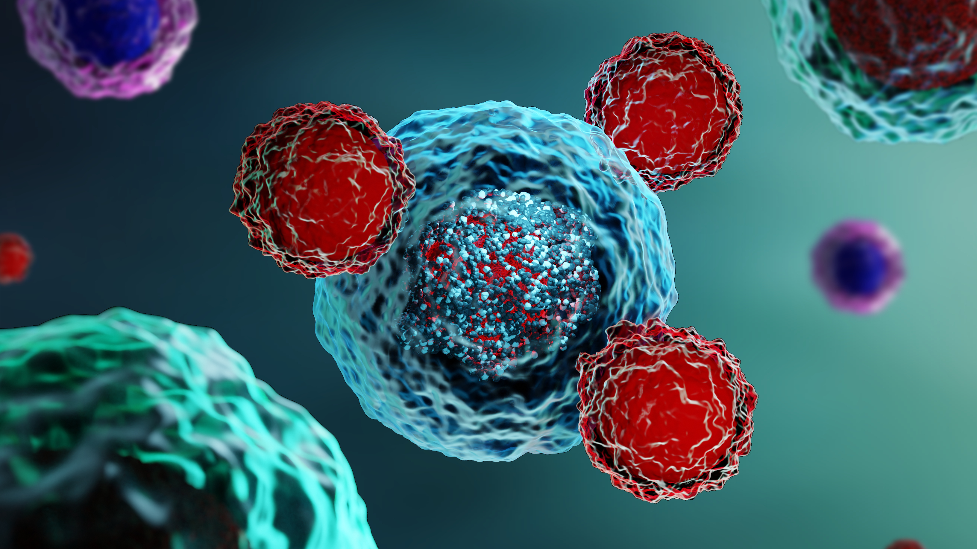
CAR T in Multiple Myeloma
Nausheen Ahmed, MD
University of Kansas Cancer Center
Notes:
Hello Everyone, I am Dr Nausheen Ahmed, Cell therapy and transplant physician from U Kansas Cancer center, presenting to you CART in multiple myeloma

Slide 2
CAR T in Multiple Myeloma
Disclosures
Ad Board: BMS
Consultancy and institutional research support: Kite
Notes:
Here are my disclosures

Slide 3
CAR T in Multiple Myeloma
Learning Objectives
Identifying eligible RRMM patients: Current indications
Efficacy and safety of approved therapies
Future and Clinical Trial Landscape
Notes:
Our objectives today: 1- identifying eligible patients and current indications. 2- Going over efficacy and safety of the approved products , namely ide-cel and cilta-cel and 3- landscape and clinical trial landscape.

Slide 4
RRMM – Pentarefractory Patients Have a Poor Prognosis
CAR T in Multiple Myeloma
Survival < 6 months
Gandhi et al. Leukemia. 2019
Notes:
To provide historical context, RRMM , pentarefractory pts have a poor prognosis with survival < 6 mo in a publication in 2019.

Slide 5
Target – BCMA on PC
CAR T in Multiple Myeloma
Ahmet et al. Blood Cancer Journal. 2020
Notes:
Since then we have had several advances , especially with the identification of BCMA as a target on plasma cells. BCMA is an ideal target because it is expressed almost 100% on PC surface and is not expressed on other organs , therefore the off target effects are minimal.

Slide 6
Approved BCMA directed CAR T in RRMM
CAR T in Multiple Myeloma
Idecabtagene vicleucel (Ide-cel)
2024 onwards, anticipate:
Approved in 2021
4 or more LOT (prior IMiD, PI, CD38 mAb)
Earlier lines
Different targets
2021
Future
Ciltacabtagene autoleucel (Cilta-cel)
Approved in 2022
4 or more LOT (prior IMiD, PI, CD38 mAb)
Notes:
Any pt with 4 Prior LOT is eligible. Prior BCMA, Prior auto transplant do not influence.

Slide 7
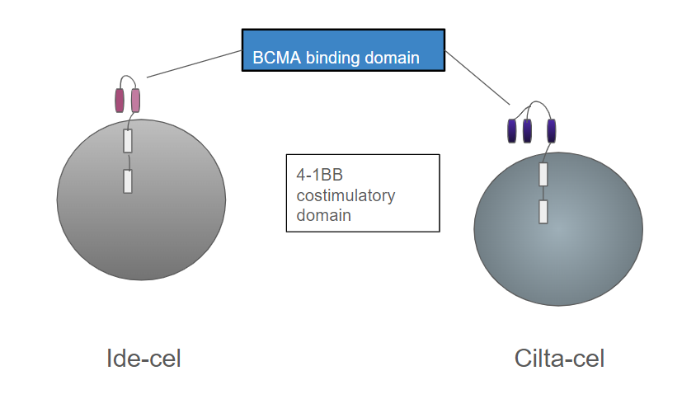
Approved BCMA directed CAR T in RRMM
CAR T in Multiple Myeloma
T Cell
T Cell
Abebe et al. Front Immunol. 2022
Anderson et al. Future Oncology. 2021
Notes:
This is a cartoon showing some differences in the construct of the CAR-T receptor . While the designed construct is slightly different, in general-- ide-cel and cilta-cel have similar co-stimulatory domains which activate the T cell. Ciltacel expresses single-domain antibodies directed against two distinct epitopes of a BCMA target antigen as opposed to ide-cel that has one.

Slide 8
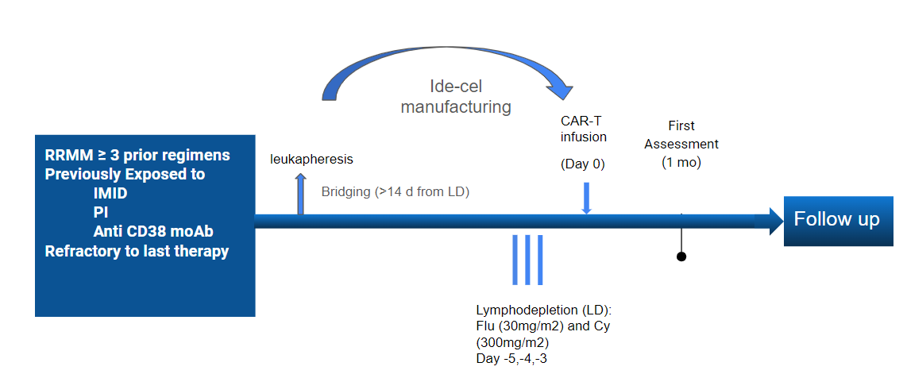
Ide-cel Approval: KarMMa-1 Study Design
CAR T in Multiple Myeloma
Munshi et al. NEJM. 2021
Notes:
We will now look at the pivotal trials that led to the approvals of these 2 novel therapies, namely the KArMMA-1 trial for ide-cel and the CARTITUDE-1 trial for cilta-cel. Both trials were single arm trials , involving leukapheresis, bridging, followed by lymphodepletion with fludarabine and cyclophosphomde and then CAR-T infusion.
For KARMMA-1 Eligible pts were those with MM who had atleast 3 lines of therapy. Exposed to IMID, PI, and anti-38 Monoclnal antibody, and all pts had to be refractory to the last therapy . Different dose levels were evaluated in KARMMA-1

Slide 9
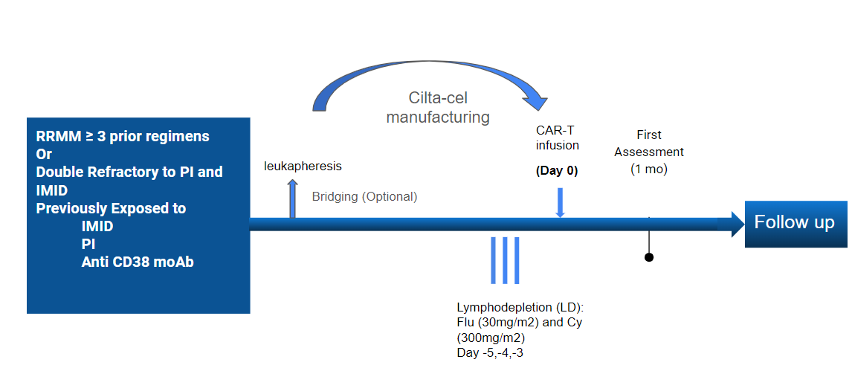
Cilta-cel Approval: CARTITUDE-1 Study Design
CAR T in Multiple Myeloma
Berdeja et al. Lancet. 2021
Notes:
CARTITUDE-1 for cilta-cel was a Phase 1b/2 Study with a fixed target dose of 0.75 million CART/kg. Pts in this study were also RRMM either who had atlest 3 LOT and previously exposed to IMID PI and anti Cd38 Monoclonal antibody. Or double refractory to PI and IMID.

Slide 10
Baseline Characteristics: KarMMa-1, CARTITUDE-1
CAR T in Multiple Myeloma
Pivotal Trial | Ph II KarMMa-1 (n=128, 3 dose levels) | Ph 1b/II CARTITUDE-1 (n=97)
CAR T | Ide-cel | Cilta-cel
Median Age | 61 (33-78) | 61 (56-68)
Median (Range) LOT | 6 ( 3-16) | 6 ( 4-8)
High Risk Cytogenetics (17p, 4:14; 14:16) | 35% | 24%
EMD | 39% | 13%
BM PC % High | ≥50% in 51% | ≥60% in 22%
Triple Refractory | 84% | 88%
Pentarefractory | 26% | 42%
Munshi et al. NEJM. 2021
Berdeja et al. Lancet. 2021
Notes:
This table outlines some baseline characteristics in the 2 studies to give an idea of some similarities and some differences in the populations studied. Again this is not a direct omparison, but numerically, it appears that the age and median LOTand triple refractory status was similar for both groups, but with the KArMM-1 study for ide-cel having more pts with high risk cytogenetics and extramed disease ; while there were more pnentarefractory pts in the cCARTITUDE-1 study.

Slide 11
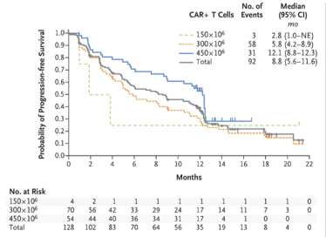
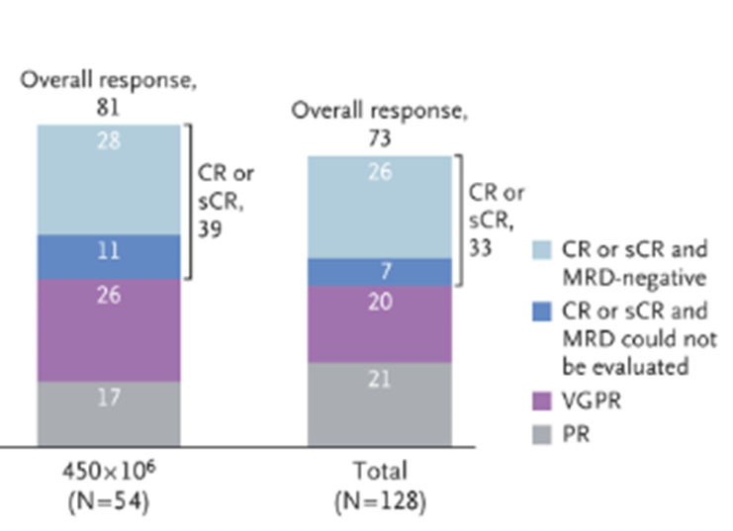
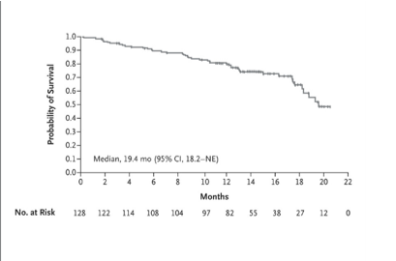
Efficacy: KarMMa-1, Ide-cel
CAR T in Multiple Myeloma
PFS by Dose Level
Efficacy Outcomes KarMMa-1
ORR | 73% (81% for target dose)
CR/sCR | 33% (39% for target dose)
PFS | mPFS: 8.8m (12.2m)
OS | mOS: 24.8 m
ORR : Max Target Dose and Overall Response
Overall Survival
Munshi et al. NEJM. 2021
Anderson et al. CLML. 2021
Notes:
Here are the outcomes for ide-cel in KARMMA-1. The ORR was 73% (81% for the target dose) with CR or better being 33%, ( 39% for the target dose). This includes responses in all subgroups, including high risk subgroups, with high risk cytogenetics/extramedullary disease/high tumor burden and R-ISS 111---
. With a 24 mo follow up , The median PFS was 8.8 no ( 12.1 mo for target dose) ; median DOR was 10.9 mo, The median DOR was not reached for those with CR or better. The medican OS was 24.8 mo and estimarted 24 mo OS rate was 51%.

Slide 12
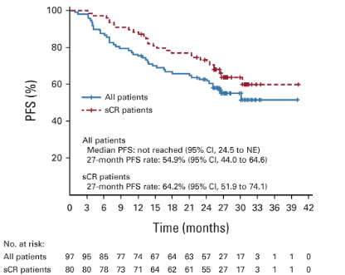
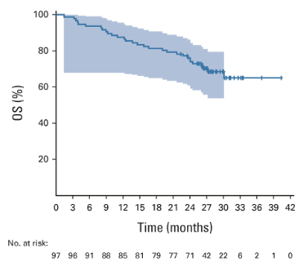
Efficacy: CARTITUDE-1, Cilta-cel
CAR T in Multiple Myeloma
PFS by Response
ORR
Efficacy Outcomes CARTITUDE-1
ORR | 98%
CR/sCR | 83% sCR at 2 yr
PFS | 12-mo PFS: 77% 18-mo PFS: 65%
Median PFS | NR
OS | 18-mo: 81%
Median OS | NR
Median DOR | NE
Overall Survival
Berdaja et al. Lancet 2021
Martin et al. JCO 2022
Notes:
The CARTITUDE-1 for cilta-cel are shown here. The ORR rate was 98% with 83% stringent CR at 2 years. The 12 mo PFs was 77%, and at 18 mo the PFS was 65%. The 18 mo OS was 81%. Median PFS, OS was not reached. Martin et al. 28 mo follow up : deep and durable responses ( Martin et al)

Slide 13
Safety: KarMMa-1 (Ide-cel),CARTITUDE-1 (Cilta-cel)
CAR T in Multiple Myeloma
 | Ide-cel | Cilta-cel
CRS: Any grade, Gr ≥3 | 84%, 5% | 95%, 4%
Onset CRS | 1 (1-12) | 7 (IQR 5-8)
ICANS: Any grade, Gr ≥3 | 18%, 3% | 17%, 2%
Onset ICANS, Median, Range | 2 (1-10) | 8 (1-28)
Other Neurotoxicity/ Parkinsonism | - | 12%
Prolonged Cytopenia | 1 mo: Gr 3+ neutropenia: 52 pts, Gr 3+ thrombocytopenia: 62 pts. | D 30: Gr 3+ neutropenia 30% ; Gr3 + thrombocytopenia 41% D 60: Gr 3 + neutropenia 12% ; Gr3 + thrombocytopenia: 6%
Infections: Any grade, Gr ≥3 | 69%, 22% | 59%; 23%
Berdeja et al. Lancet. Munshi et al. NEJM. 2021
Notes:
I will highlight some of the adverse effects and toxicities and again bring in the AE outcomes in both studies here for a rough visualization of any differences. Cytokine release syndrome occurred very frequently with both products, with 5% or less high grade CRS. The time too onset of CRS is different, with median 1 day for ide-cel and 7 days for cilta-cel. Similarly Immune effector cell therapy induced neurotoxicity syndrome was around 17-18% for both producrts with less than 5% high grade incidences. Time to onset again varied – being median 2 days to onset for idecel and 8 for cilta0ce;
Interestingly, the CARTITUDE-1 reportrs other neurotoxicity- movement disorders, such as parkinsonism in 12% while ihis was not present for KARMMMA-1 population. There were toxicities including prolonged cytopenia in atlaeast a third of pts at DAy 30. and around 2/3 pts getting an infection of any fgrade, with 22-23% being Grade 3 or high .
Ciltacel: Lee criteria for CRS and ASTCT; Neurotoxicity was graded using NCI-CTCAE v5.0 in phase Ib, and immune-effector cell-associated neurotoxicity syndrome (ICANS) was graded by ASTCT criteria²¹ in phase II. Other neurotoxicities (events not reported as ICANS) were graded by NCI-CTCAE version 5.0.

Slide 14
Future: BCMA and non-BCMA Cellular Therapy Era
CAR T in Multiple Myeloma
Ide-cel
(BCMA CAR T)
in 4+ line
2021
Cilta-cel
(BCMA CAR T)
in 4+ line
2022
Earlier lines
GPRC5D CAR T
Other targets
Manufacture platforms for CAR T
Allogeneic CAR T
Notes:
These 2 studies led to the approval for Ide-cel and cilta-cel for pts who failed 4 lot . The next step in the evolution of CAR-T will likely be approval of these therapies , idecel and ciltaa-cel in earlier lines. There are other advances that we will also touch on as future developments, including novel targets, allogeneic CART, improvement in manufacture platforms since presently manufacture time is about 4-8 weeks.

Slide 15
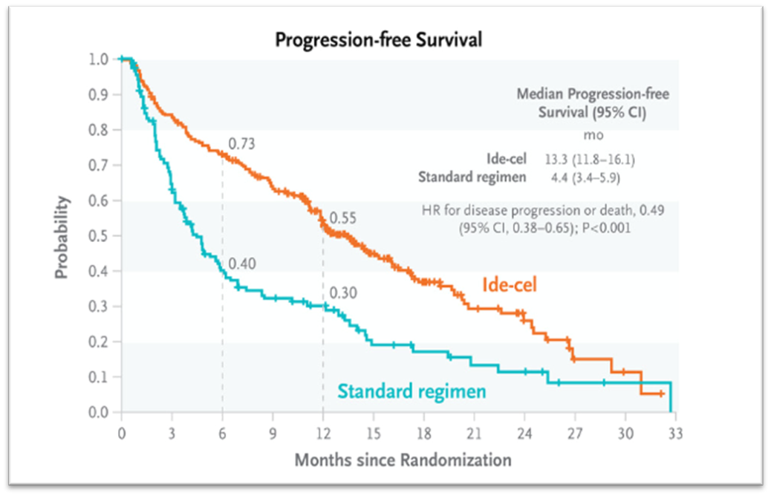
Earlier Lines: KarMMA-3, Ide-cel
CAR T in Multiple Myeloma
KarMMa-3 (Ide-cel vs SOC) | KarMMa-3 (ide-cel vs SOC)
Design | Randomized Ph 3, 2-4 prior LOT, triple exposed, refractory to last therapy.
Pts Enrolled | 381 pts (2:1 randomization)
SOC | DPd, DVd, ixa-RD, Kd or Elo-Pd
High Risk Cytogenetics | 42% vs 46%
Median LOT | 3
Triple Class Refractory | 65% vs 67%
Dara Refractory | 95%
Response | Ide-cel vs SOC
ORR (PR or better) | 71% vs 42%
Best response CR or sCR | 39% vs 5%
Median DOR | 14.8mo vs 9.7 mo
MRD neg | 20% vs 1% (3 mo)
Median PFS | 13.3 vs 4.4 mo
12 mo PFS | 55% vs 30%
Rodriguez-Otero P et al. NEJM. 2023
Notes:
Lets first talk about the anticipated earlier approvals. We have the KARRMA-3 for Idecel, which is a phase 3 trial that enrolled pts wio had 2-4 LOT, triple exposed and therapy. There was a 2:1 randomization to either ide-cel or SOC. SOC was defined as DPD, DVD, Ixa-RD, KD, Elo PD. responses are shown in the table in the middle, which clearly favors ide-cel over SOC. The ORR was 71%, with over the half the responses being complete responses or better. CR was 39%, almost 8 times the CR in the SOC arm and Median DOR 14.8 mo . The MRD neg 20% compared to only 1% in the SOC group, . Median PFS was 13.3 mo , triple the SOC. The FDA Oncologic Drug Advisory Committee on March 15^{th 2024}, voted that in favor of moving ide-cel to earlier lines of therapy and now the final approval decision by FDA is awaited.

Slide 16
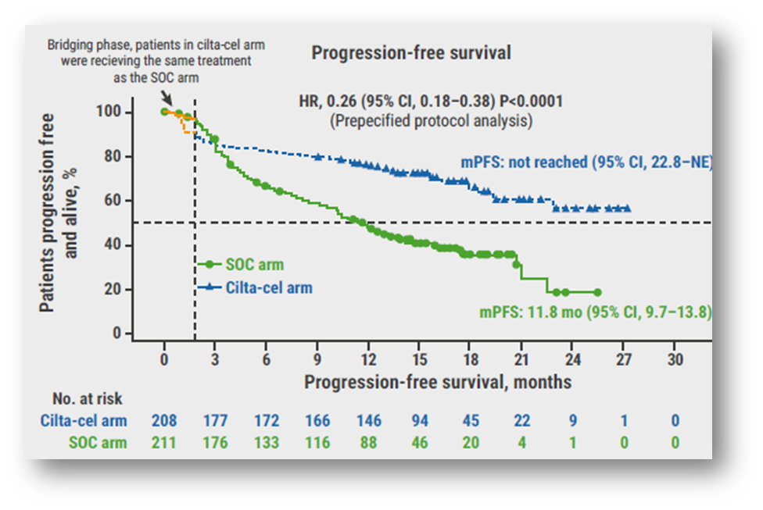
Earlier Lines: CARTITUDE-4, Cilta-cel
CAR T in Multiple Myeloma
CARTITUDE-4 (cilta-cel vs DPD, PVd) | CARTITUDE-4 (cilta-cel vs DPD, PVd)
Design | Randomized ph 3, pts with 1-3 prior LOT, lenalidomide refractory
Pts Enrolled | 419 pts (1:1 randomization)
SOC | DPD or PVd
High Risk Cytogenetics | 59.4% vs 62.9%
Median LOT | 2
Triple Class Refractory | 14.4 vs. 15.6%
Dara Refractory | 48% vs. 45%
Response | Cilta-cel vs SOC
ORR (PR or better) | 99.4% (84.6% in IIT) vs 67.3%
Best response CR or sCR | 86.4% (73.1% in IIT) vs 21.8%
Median DOR | NR vs 16.6 mo
MRD neg | 87.5% vs 32.7% (any timepoint)
Median PFS | NR vs 11.8 mo
12 mo PFS | 76% vs 49%
Death | 18.8% vs 22%
Notes:
Ciltacel was studied in CARTITUDE -4 for earlier indication too. This was ciltacel vs SOC ( DPD pr PVD- pom bortezomib dex). 419 pts were enrolled ith 1:1 randomization. Median LOT ws 2 . The outomes are in the middle table again favoring ciltacel compared to SOC. ORR was 99.4% in those who received Ciltacel and 67.3% in intention to treat population. The IIT population includes those who were leukapharessed and did not get the CAR infusion. Most of these responses were CR or better. CR rate of 86% was over 4 times the SOC. Median PFS and DOR was not reached. 12 mo PFS was 76% vs 49% . OS data continues to mature. Mortality was similar in both groups. The FDA Oncologic Drug Advisory Committee on March 15th, voted that in favor of moving cilta-cel to earlier lines of therapy and now the final approval decision by FDA is awaited.

Slide 17
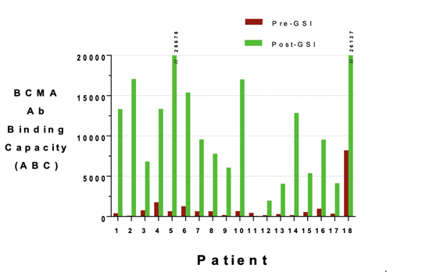
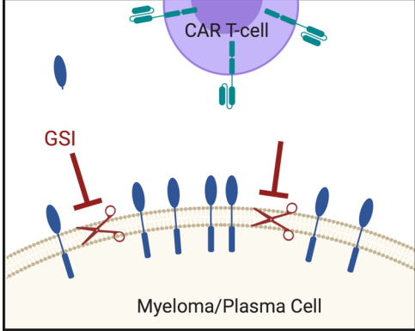
Future: Combinations to Improve Efficacy: JSMD194
CAR T in Multiple Myeloma
Safety and Efficacy of Fully Human BCMA CAR T Cells in Combination with a Gamma Secretase Inhibitor to Increase BCMA Surface Expression in Patients with Relapsed or Refractory Multiple Myeloma
lymphodepletion → BCMA CAR T (5 x 10 ⁷ CAR+ cells)+ JSMD194 25 mg 3 times a week for 3 weeks, starting on the day of CAR infusion.
Cowen et al. ASH 2021
Cowen et al. ASH 2019
Pont MJ et al. Blood. 2019
Notes:
There are also other trials that are expected to improve up on these outcomes with presently approved therapies. I will highlight a few. Here in this picture is a novel agent, depiction of using a gamma secreatase inhibitor, which prevents cleavage of BCMA from the surface of PC. Combinations with GSI is being studied to evaluate increase binding and therefore efficacy of the BCMA directed CART. Other combinations and sequencing strategies, especially with the BCMA and GPRC5D bispecifics, teclistimab and talquetamab, are also being evaluated in trials.

Slide 18
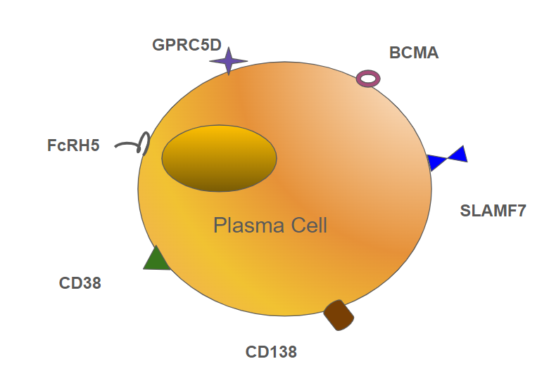
Future: non-BCMA Targets
CAR T in Multiple Myeloma
Huang et al. J Zhejiang Univ Sci B. 2020
Jiang et al. Nat Commun. 2023
Kegyes et al. J Hematol Oncol. 2022
Mailankody et al. NEJM. 2022
Notes:
Moreover, Novel targets for CARs are in development, such as those targeting GPRC5D and FcRH5.

Slide 19
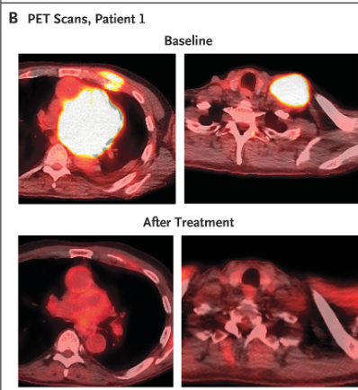
GPRC5D targeting CAR T
CAR-T in Multiple Myeloma
Phase 1 First-in-Class Trial of MCARH109, a G Protein Coupled Receptor Class C Group 5 Member D (GPRC5D) Targeted CAR T-Cell Therapy in Patients with Relapsed or Refractory Multiple Myeloma
Mailankody et al. ASH 2021. NEJM. 2022
Notes:
For example, MCARH109 is a GPRC5D targeting CARt, and shown here is a pt with a plasmacytoma of the chestwall showin in the picture, which reponsed beautifully to trt with this CAR. In a study of 19 pts in the phase 1 study using this CAR.

Slide 20
Future: Allogeneic Constructs
CAR T in Multiple Myeloma
Caldwell et al. Front Immun. 2021
Notes:
Other important efforts are directed towards the CAR platform. For autologous products that means improving he mansufacturte time and predictability. Also this includes developing allogeneic platoforms, where the T cells are not from the patients, but rather from a third party, healthy donor or similar source. The allogeneic platform has advantages such as the product being off the shelf, readily available. There are many studies with allogeneic CART ongoing, all with unique designing to mitigate the risk of GVHD and rejection,

Slide 21
Summary: BCMA CAR T in RRMM
CAR T in Multiple Myeloma
Eligible Patients
RRMM
Safety/Efficacy
Ide-cel
Future
Earlier lines:
Novel Constructs/Targets
Refractory to 4 LOT
Cilta-cel
Approvals expected based on KarMMa-3 and CARTITUDE-4
Manufacturing Platform
Sequencing with bispecifics
Notes:
So in summary, some take homw points. All patients with RRMM who have had 4 LOT are presently eligible for CART consideration, which presently includes either ide-cel or cilta-cel. This may soon change to be earlier in the trt course.
The early toxicities include cytokine release and ICANS, and also prolonged cytopenia and risk of infections. There is a risk of movement disorders to be aware of. There are many studies ongong evaluating CART in earlier lines, evaluating novel targets and contstricts and sequencing and combination strategies.

Slide 22
Thank You
Please contact Hailey Honeycutt (hailey@aaci-cancer.org) with feedback, comments, or questions regarding this content.
Notes:
Thank you

